Slide 1
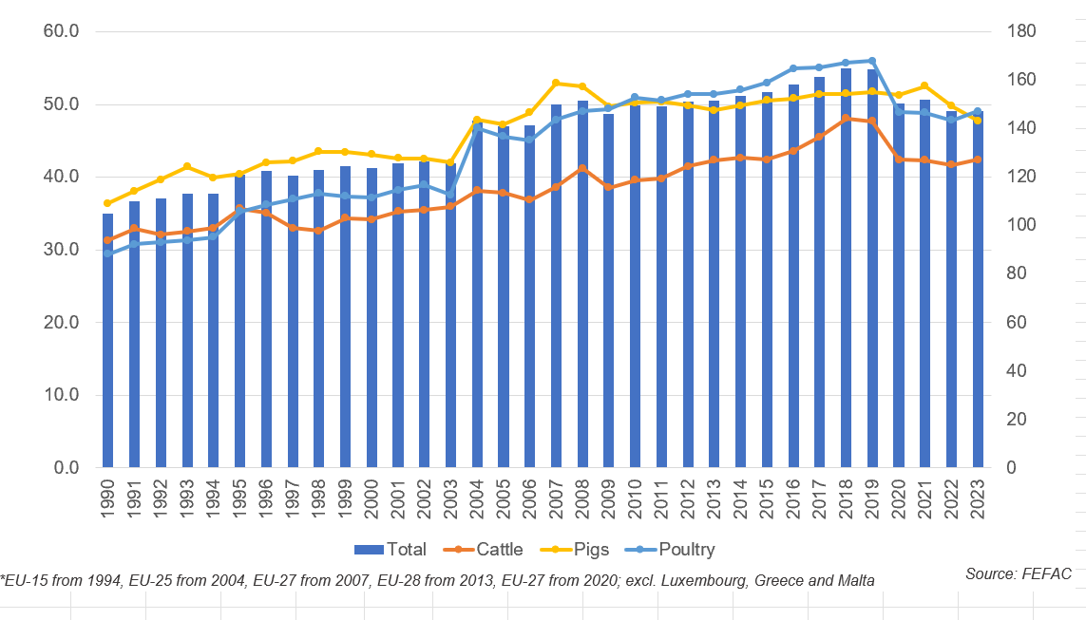
Change in EU production of compound feed for cattle, pig and poultry 1990-2023

